Slide 1
CalSafe
Capstone Project by Henry Dinh, Kyle O’Kelley, Sohrab Bahari
https://github.com/Cloudymizu/calsafe
https://docs.google.com/document/d/1896Gf45tXzr1Rcto8DcmjLDHqkc2dWb_qhqDmag8bJ8/edit?usp=sharing

Slide 2
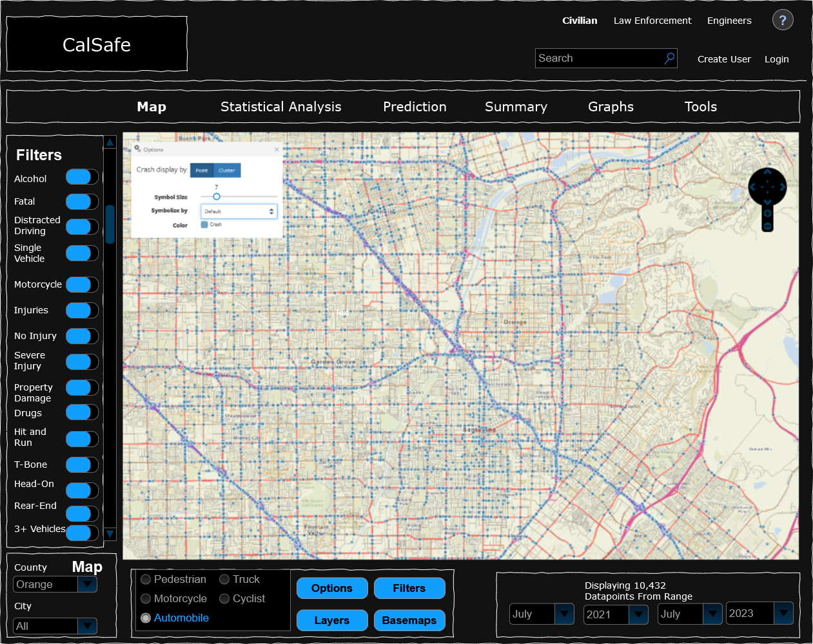
Introduction to CalSafe
CalSafe is a web application that is designed as a way to increase awareness about traffic safety
Has a database populated with all accident data in SoCal from 2018 to 2023
Query results show all accidents according to selected county, date, and filter settings
Map is populated with data points according to query results.
The statistics page will show basic and advanced statistics for the data based on query.
Machine learning will be implemented to predict future accident trends.
What the Application might look like

Slide 3
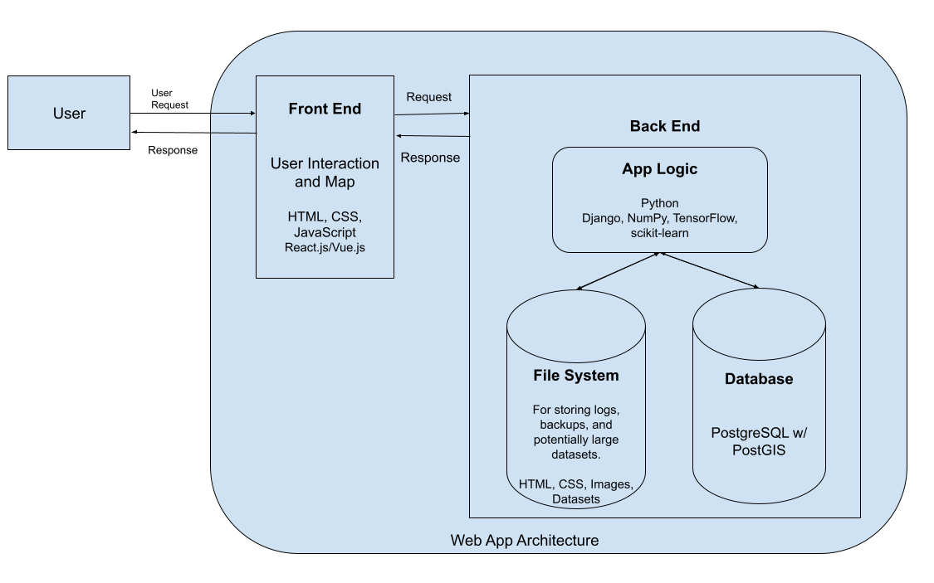
Implementation Details
Front-End
Next.JS (based on React)
Leaflet.JS
Written Primarily In
TypeScript/JavaScript
CSS
Back-End
Django
PostgreSQL with PostGIS
NumPy
TensorFlow
Written Entirely In Python

Slide 4
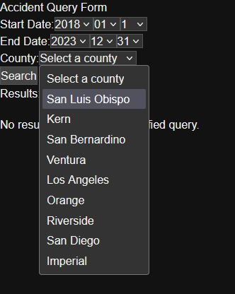
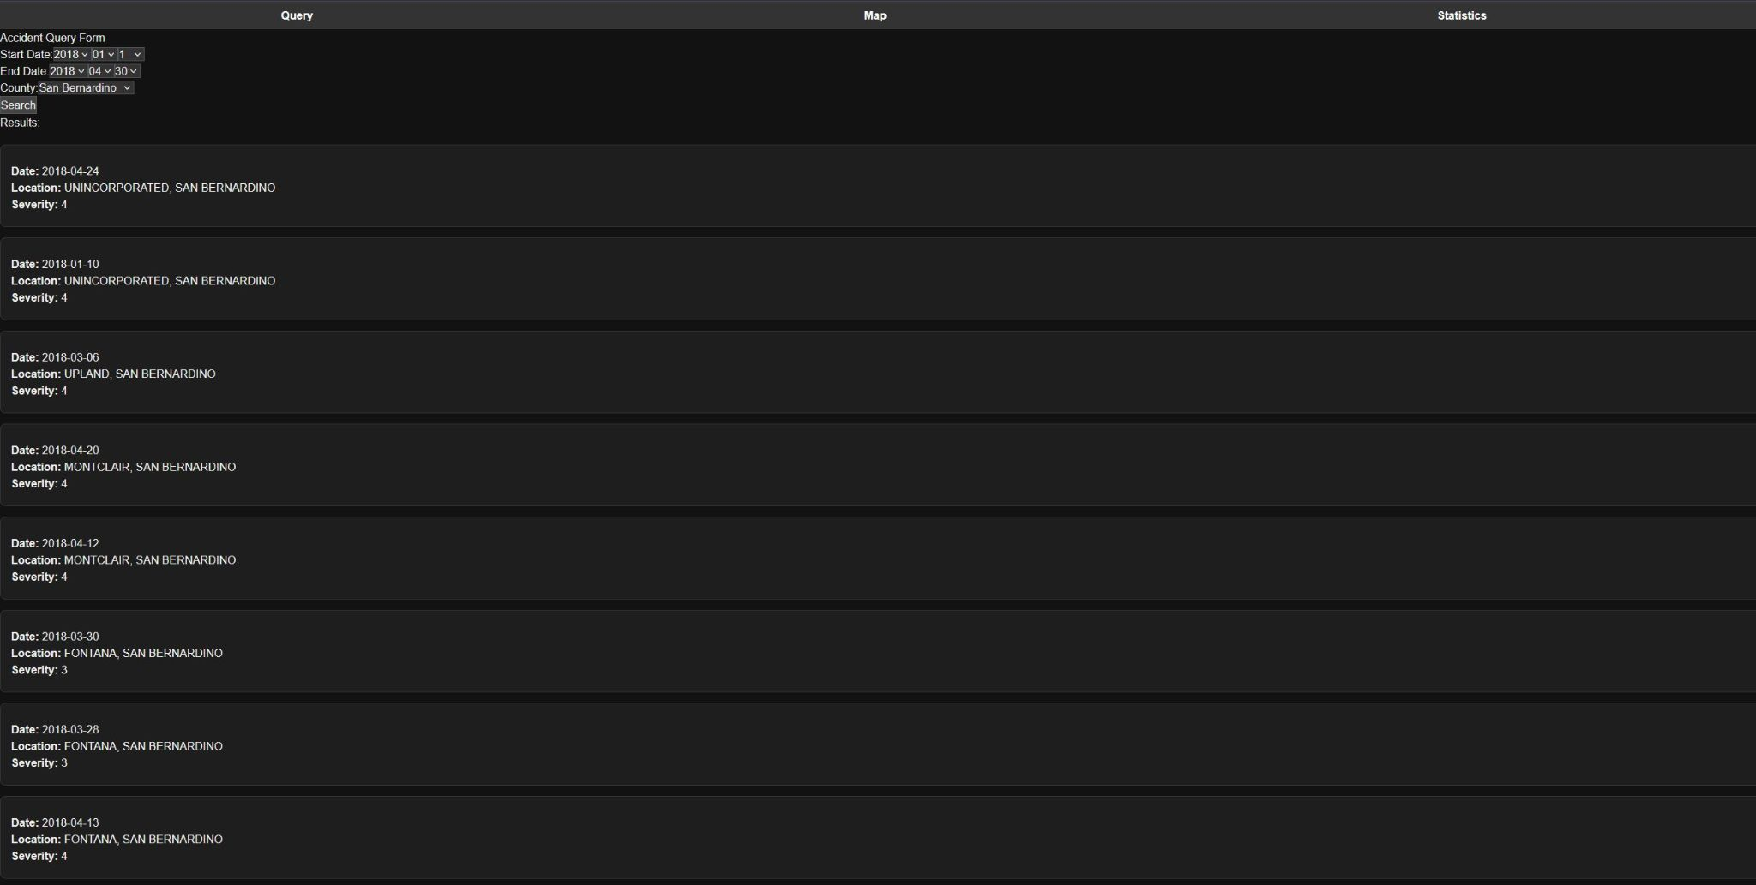
Project Work
Temporary Query Page and Results

Slide 5
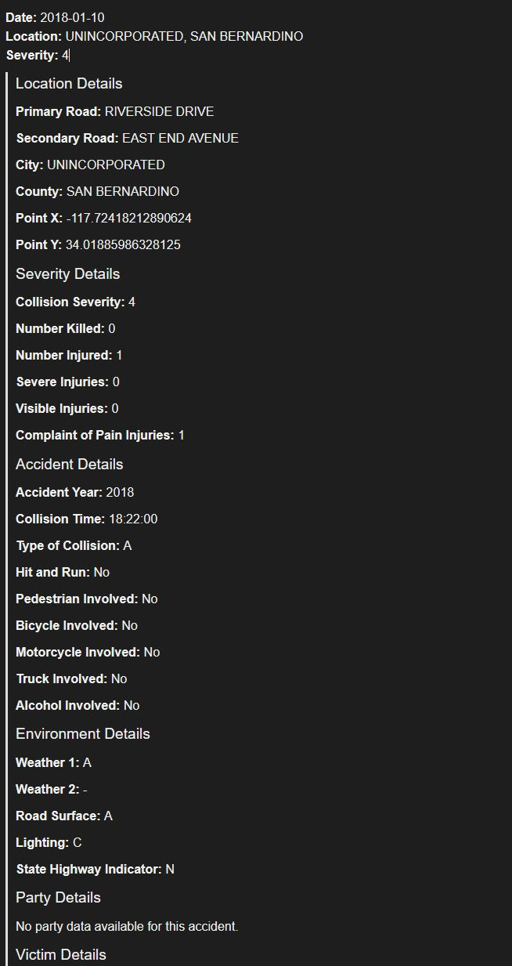
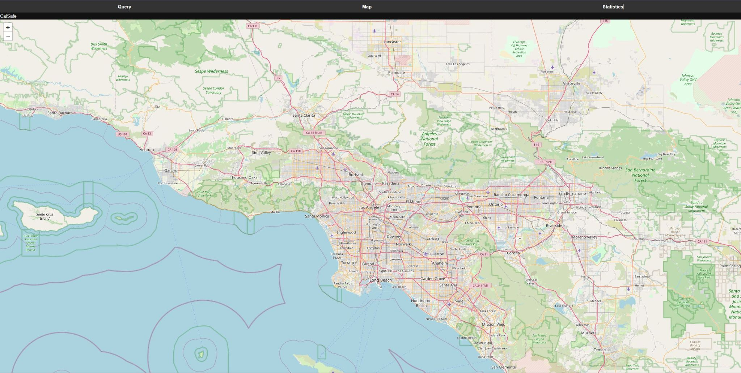
Project Work
Query result and temp map yet to be populated

Slide 6
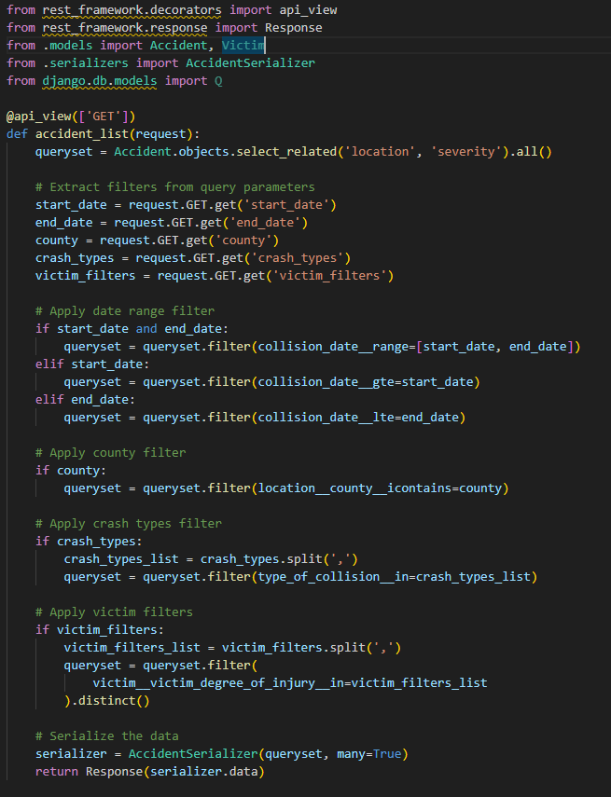
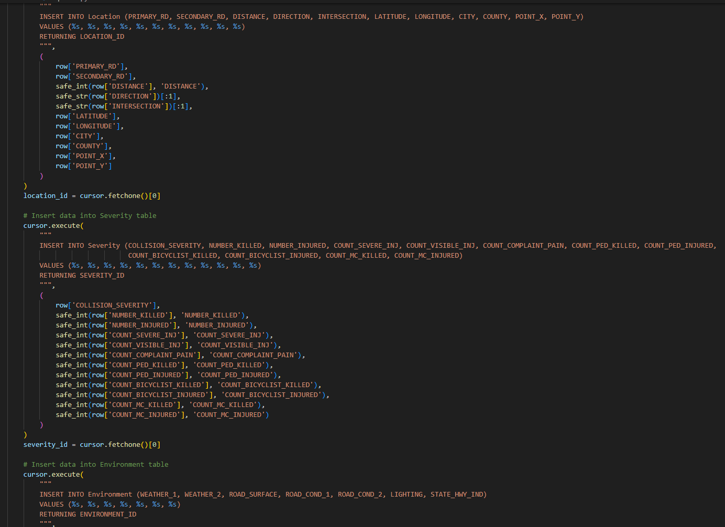
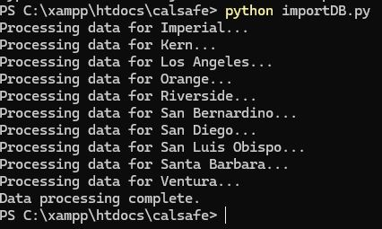
Summary of Tasks Finished
Database Setup
Database Population
Data Cleaning
Backend Setup
Frontend Setup
Map Setup
Query Setup
API

Slide 7
Remaining Tasks to Finish
Link Query Results to Map
Make every point on the map display crash information
Implement more advanced filtering
Planned to be finished by end of this month
Clean, Tidy, Informative Web Page design
Make the website look presentable and easy to use
Planned to be finished by end of this month
Statistics Page
Display general statistics according to query dates, location, additional filters.
Composed of Graphs and basic statistical analysis and trends
Basic page planned to be finished by end of month, all features by end of November
AI Prediction (November-December)
Use machine learning for future trend prediction
Development to begin start of November, planned completion by December

Slide 8
Thank You!

